Slide 1
The Limits to Growth: Sustainability and the Circular Economy
Lecture 5: Limits to Growth and Planetary Boundaries
Prof. Dr. Benjamin Leiding
M.Sc. Anant Sujatanagarjuna
M.Sc. Nelly Nicaise Nyeck Mbialeu

Slide 2
License
This work is licensed under a Creative Commons Attribution-ShareAlike 4.0 International License. To view a copy of this license, please refer to https://creativecommons.org/licenses/by-sa/4.0/ .
Updated versions of these slides will be available in our Github repository.

Slide 3
News/Updates

Slide 4
News/Updates
Lecture Plan – Update
Date | Lecture Title
30.10.2024 | L00 – Organisation L01 – Introduction
06.11.2024 | L02 – Challenges I – Climate Change
13.11.2024 | L03 – Challenges II – Environmental Pollution and Resources
20.11.2024 | L04 – A History of Political (In-) Action (Flipped Classroom → MOOC@Home + Live Lecture)
27.12.2024 | L05 – Overshoot, the Limits to Growth and Planetary Boundaries
04.12.2024 | L06 – LifeCycle Assessment (LCA) (Flipped Classroom → MOOC@Home + Live Lecture)
11.12.2024 | L07 – Ethics and Morals of Sustainability
18.12.2024 | L08 – Circular Economy (Flipped Classroom → MOOC@Home + Live Lecture)
08.01.2025 | L09 – Circular Societies (MOOC)
15.01.2025 | L10 – Beyond the Circular Economy I
22.01.2025 | L11 – Invited Lecture (Gabriel from the CatFarm project) - Power in Balance: Horizontal Governance for Collaborative Communities
29.01.2025 | L12 – Beyond the Circular Economy II
05.02.2025 | L13 – Complex Societies and Technology L14 – Summary
12.02.2025 | Exam Q&A

Slide 5
News/Updates
E02 – Resource Scarcity
Goal: Investigating and tackling the challenges of shared resource management. Use Case → Fishing in the Atlantic Ocean.
Key concepts:
Overexploitation – over use of common resource leads to its depletion
Individual vs. Collective benefits – one’s own interest or group welfare
Sustainability – management and preservation strategies
Regulation and Cooperation – prevent tragedyses uncertainties about humanity's future and the risk of severe or irreversible environmental changes

Slide 6
News/Updates
E02 – Resource Scarcity
Recurrent suggestions on how to address the challenges posed by the game, categorized:
Regulation:
Fishing quotas
Special protected areas
Licence mechanisms
Seasonal restrictions
Taxes and monetary benefits
Monitoring and Technology:
Ocean police
Fish population tracking in real-time, e.g., satellite tracking
Predictive technology to calculate recovery rates of fish population
Education and Incentives:
Encouraging sustainable practices
Fishing cooperatives

Slide 7
News/Updates
E02 – Resource Scarcity
Recurrent suggestions on how to address the challenges posed by the game, categorized:
Regulation:
Fishing quotas
Special protected areas
Licence mechanisms
Seasonal restrictions
Taxes and monetary benefits
Monitoring and Technology:
Ocean police
Fish population tracking in real-time, e.g., satellite tracking
Predictive technology to calculate recovery rates of fish population
Education and Incentives:
Encouraging sustainable practices
Fishing cooperatives

Slide 8
News/Updates
E02 – Resource Scarcity
Recurrent suggestions on how to address the challenges posed by the game, categorized:
Regulation:
Fishing quotas
Special protected areas
Licence mechanisms
Seasonal restrictions
Taxes and monetary benefits
Monitoring and Technology:
Ocean police
Fish population tracking in real-time, e.g., satellite tracking
Predictive technology to calculate recovery rates of fish population
Education and Incentives:
Encouraging sustainable practices
Fishing cooperatives

Slide 9
News/Updates
E02 – Resource Scarcity
Recurrent suggestions on how to address the challenges posed by the game, categorized:
Regulation:
Fishing quotas
Special protected areas
Licence mechanisms
Seasonal restrictions
Taxes and monetary benefits
Monitoring and Technology:
Ocean police
Fish population tracking in real-time, e.g., satellite tracking
Predictive technology to calculate recovery rates of fish population
Education and Incentives:
Encouraging sustainable practices
Fishing cooperatives

Slide 10
Ineffectiveness of UN sanctions brings in the need for a global organization that oversees sustainable fishing and establishing tax incentives.
News/Updates
Countries work together to establish fishing cooperatives and implement sustainable fishing methods in shared waters.
E02 – Resource Scarcity
Establish fishing activities restriction based on scientific data and the natural replenishment rate of species.
Global regulatory bodies
Establish cultural shift in fishing communities or just prohibit fishing at a certain point.
Cooperative agreements among countries
Science-Based Recovery Rates
Overcoming greed

Slide 11
News/Updates
E02 – Resource Scarcity
Some challenges were observed:
Enforcing laws or sanctions in international waters can be problematic due to economic and political interests (UN failed).
Financial motivations behind overfishing as some people will make less profits since they usually fish the most/fastest.
Absence of international collaboration as not all countries agree to the same sustainable fishing practices.ainties about humanity's future and the risk of severe or irreversible environmental changes

Slide 12
News/Updates
E02 – Resource Scarcity
Open discussion
How could cooperation and collaboration be encouraged across borders?
What is really understood by the global ocean law and how feasible is that?
How possible can economic growth be balanced with sustainability practices?
What else could be a solution to the challenge of shared resource management?

Slide 13
News/Updates
E03 – Environmental Pollution (Follow-Up E01)
Avoidable purchases
Used plastic bags even though had a reusable cloth bad
Could have avoided buying chocolate bars that is wrapped in plastic
Bought plastic packaged goods from the supermarket instead of at the bakery
Reusable items
Glass jar from pasta sauce could have been cleaned and used for spices storage
PET bottles could be reused as vases for flowers
Repurposed a “mini snack salami” package into storage container
Supply Chain redesign
Producers could switch to reusable glass containers that customers can return for recycling
Replace single-use plastic packaging with biodegradable materials
Add refill stations for products like shampoos to reduce packaging waste

Slide 14
News/Updates
E03 – Environmental Pollution (Follow-Up E01)
Further proposals:
Switching to refill stations for products like rice, perfume.
Using leftover toast to create croutons or French toast.
Removing unnecessary packaging like sealing individual fruits or vegetables in plastic.
Make coffee at home to avoid the selling of coffee to-go cups.
Crossing these boundaries increases uncertainties about humanity's future and the risk of severe or irreversible environmental changes

Slide 15
News/Updates
E03 – Environmental Pollution (Follow-Up E01)
Open discussion
How could cooperation and collaboration be encouraged across borders?
What is really understood by the global ocean law and how feasible is that?
How possible can economic growth be balanced with sustainability practices?
What else could be a solution to the challenge of shared resource management?
Crossing these boundaries increases uncertainties about humanity's future and the risk of severe or irreversible environmental changes

Slide 16
Introduction

Slide 17
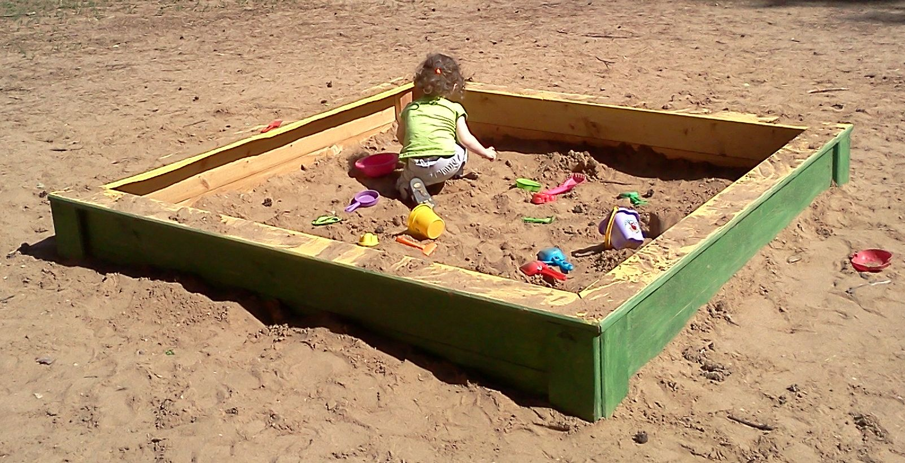
Introduction
Finite Systems – Sandbox / Playground
Al Silonov – https://commons.wikimedia.org/wiki/File:Sandbox-2013.jpg – CC BY-SA 4.0.

Slide 18

Introduction
Earth Overshoot Day
Earth Overshoot Day
1970-2022
1 Earth
1.75 Earths
December
November
October
September
August
July
June
May
April
March
February
January
Figure adapted from https://www.overshootday.org/newsroom/past-earth-overshoot-days/

Slide 19
Introduction
Lotka–Volterra Equations (Predator–Prey Equations)

Slide 20
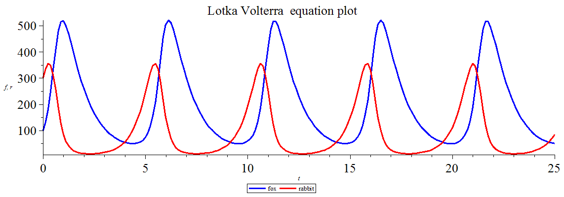
Introduction
Lotka–Volterra Equations (Predator–Prey Equations)
Gisling – https://commons.wikimedia.org/wiki/File:Lotka_Volterra_equation_Maple_plot.png – CC BY-SA 3.0.

Slide 21

Introduction
The Limits to Growth – 1972

Slide 22
Introduction
The Limits to Growth
“If the present growth trends in world population, industrialization, pollution, food production, and resource depletion continue unchanged, the limits to growth on this planet will be reached sometime within the next one hundred years.
The most probable result will be a rather sudden and uncontrollable decline in both population and industrial capacity.”
Meadows (1972) – The Limits to Growth

Slide 23
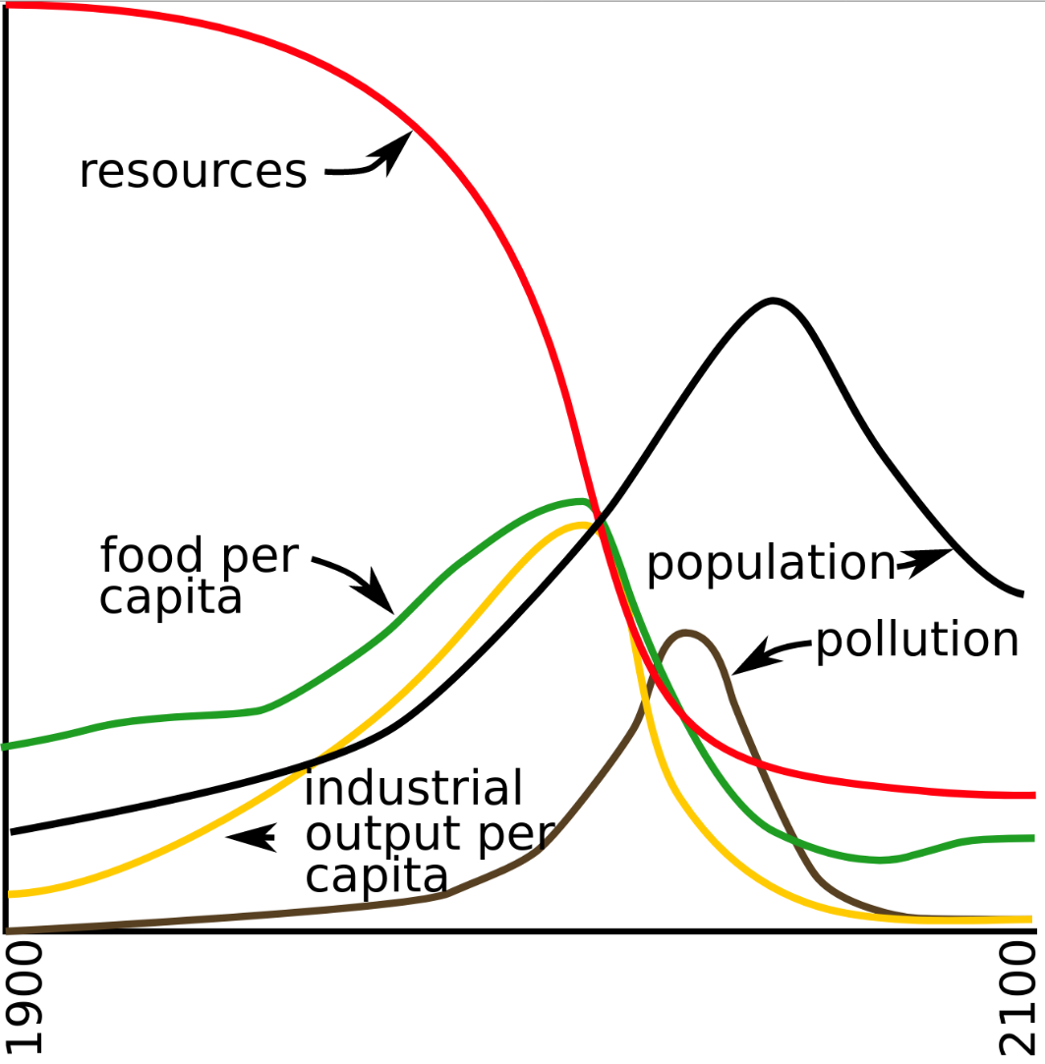
Introduction
The Limits to Growth – World3 Standard Run
Reconstruction by YaguraStation of Figure 35. page 124 of The Limits to Growth (1972) is licensed with CC BY-SA 4.0. To view a copy of this license, visit https://creativecommons.org/licenses/by-sa/4.0/

Slide 24
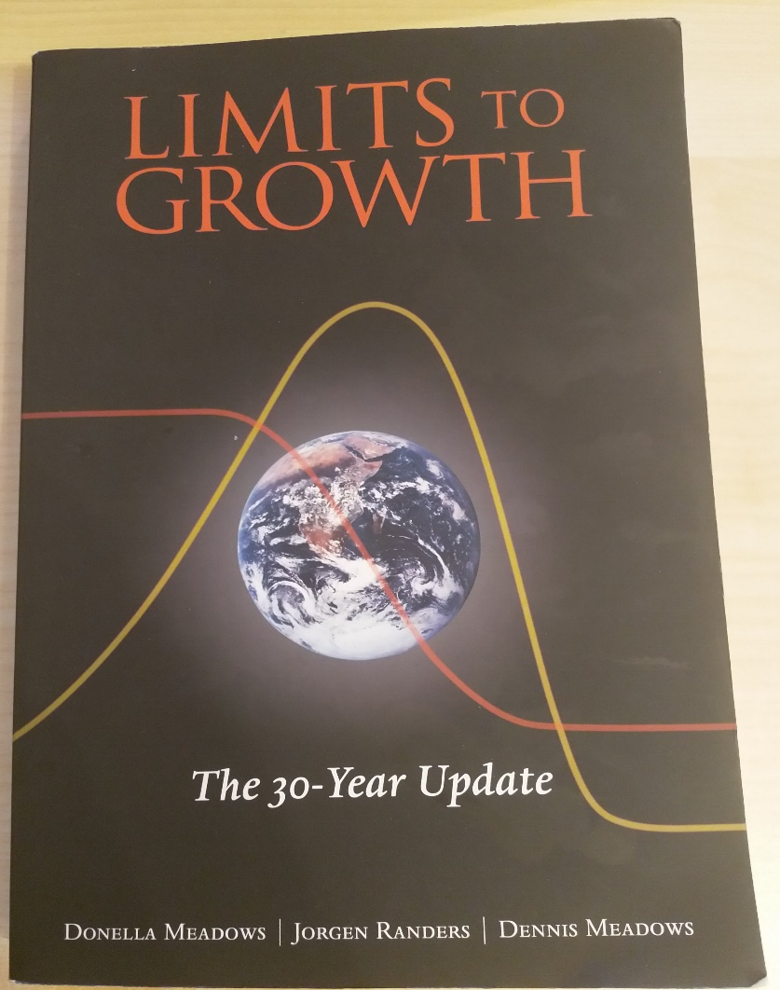
Introduction
The Limits to Growth – 1972 / 2004

Slide 25
Introduction
The Limits to Growth – World3 Model
Click Me
Click Me

Slide 26
Planetary Boundaries

Slide 27
Planetary Boundaries
Concept
First proposed by researchers led by Johan Rockström from the Stockholm Resilience Centre in 2009
Quantitative planetary boundaries within which future generations can continue to exist
Based on nine indicators that are of high importance for the stability and resilience of the Earth system
Crossing these boundaries increases uncertainties about humanity's future and the risk of severe or irreversible environmental changes

Slide 28
Planetary Boundaries
Concept
First proposed by researchers led by Johan Rockström from the Stockholm Resilience Centre in 2009
Quantitative planetary boundaries within which future generations can continue to exist
Based on nine indicators that are of high importance for the stability and resilience of the Earth system
Crossing these boundaries increases uncertainties about humanity's future and the risk of severe or irreversible environmental changes

Slide 29
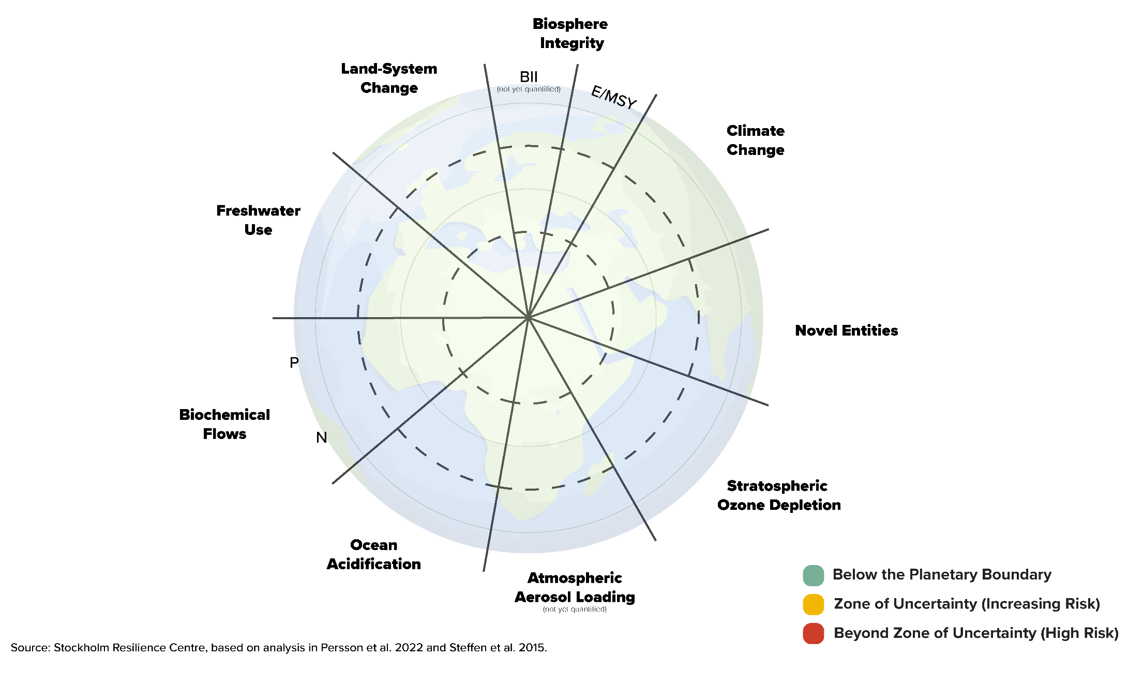
Planetary Boundaries
Concept

Slide 30
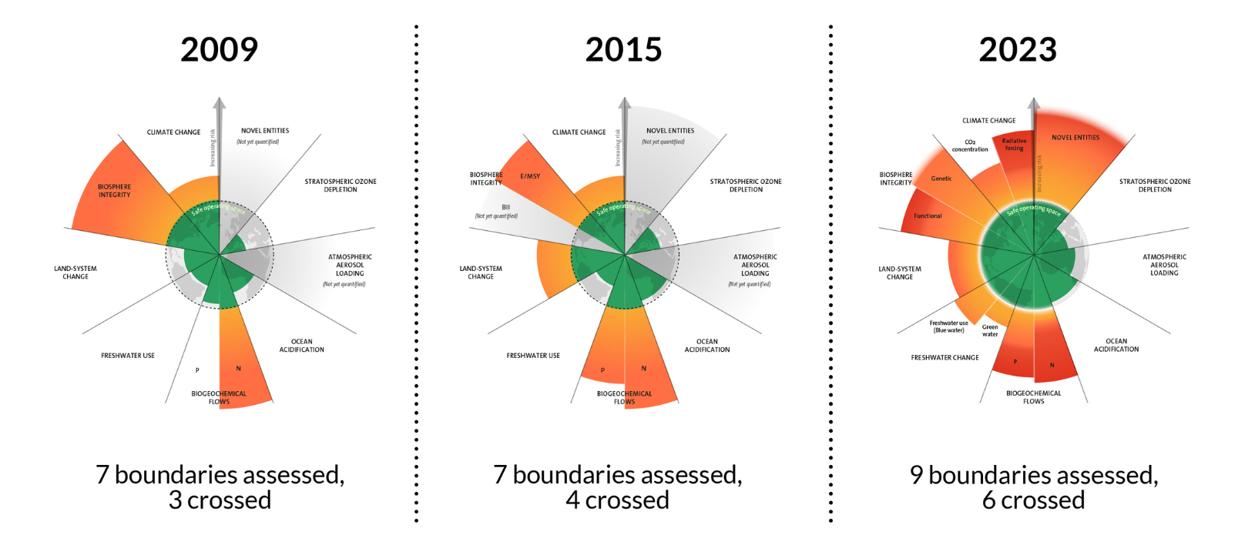
Planetary Boundaries
The evolution of the planetary boundaries framework. Licenced under CC BY-NC-ND 3.0 (Credit: Azote for Stockholm Resilience Centre, Stockholm University. Based on Richardson et al. 2023, Steffen et al. 2015, and Rockström et al. 2009)

Slide 31
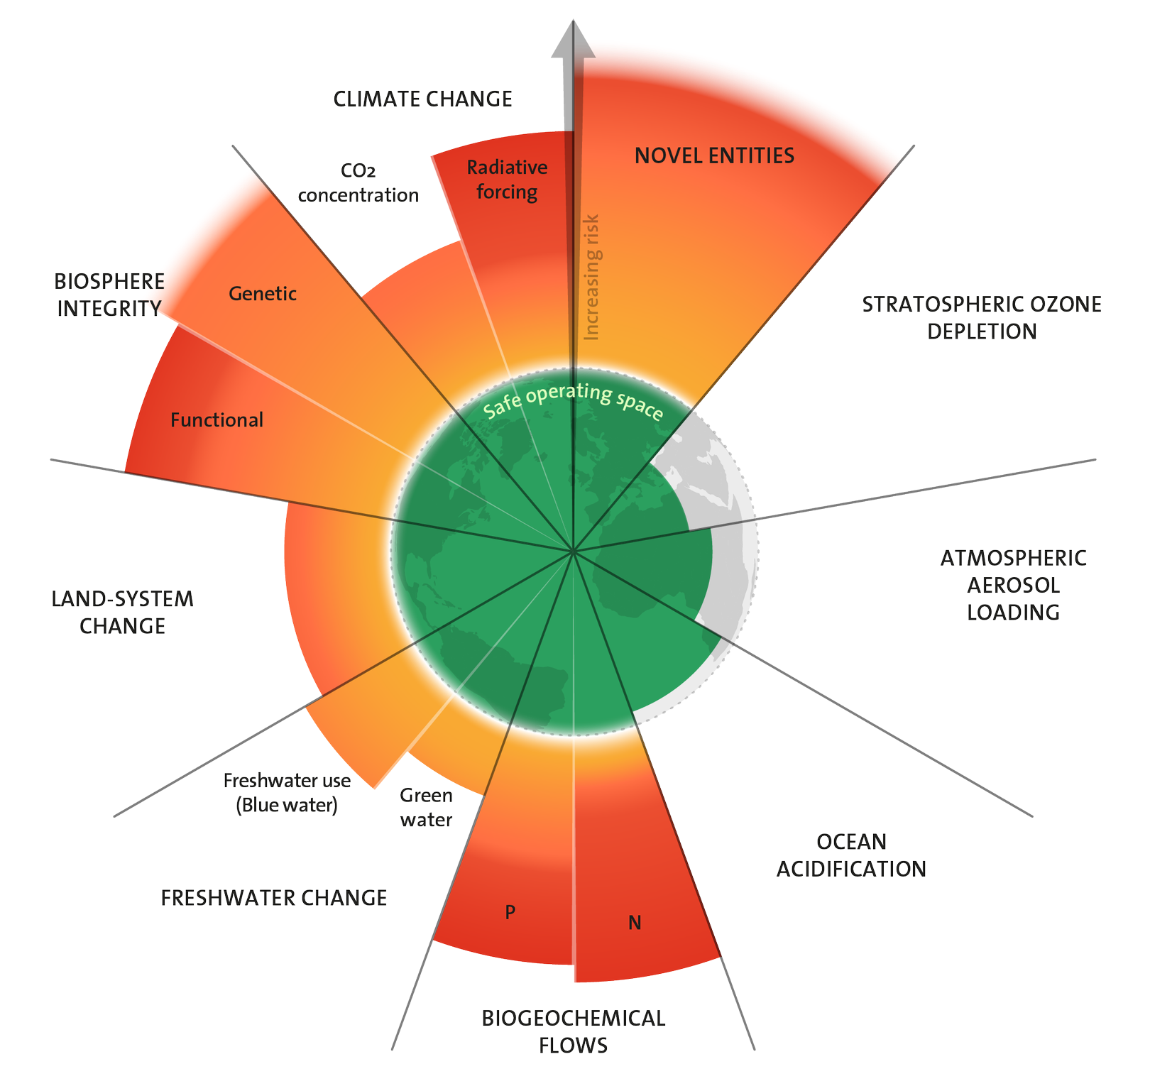
Planetary Boundaries
2023
All boundaries are finally assessed
Six boundaries are now transgressed and pressure is increasing on all boundary processes → only exeption is the ozone depletion
Azote for Stockholm Resilience Centre, based on analysis in Richardson et al 2023 – CC BY-NC-ND 3.0.

Slide 32
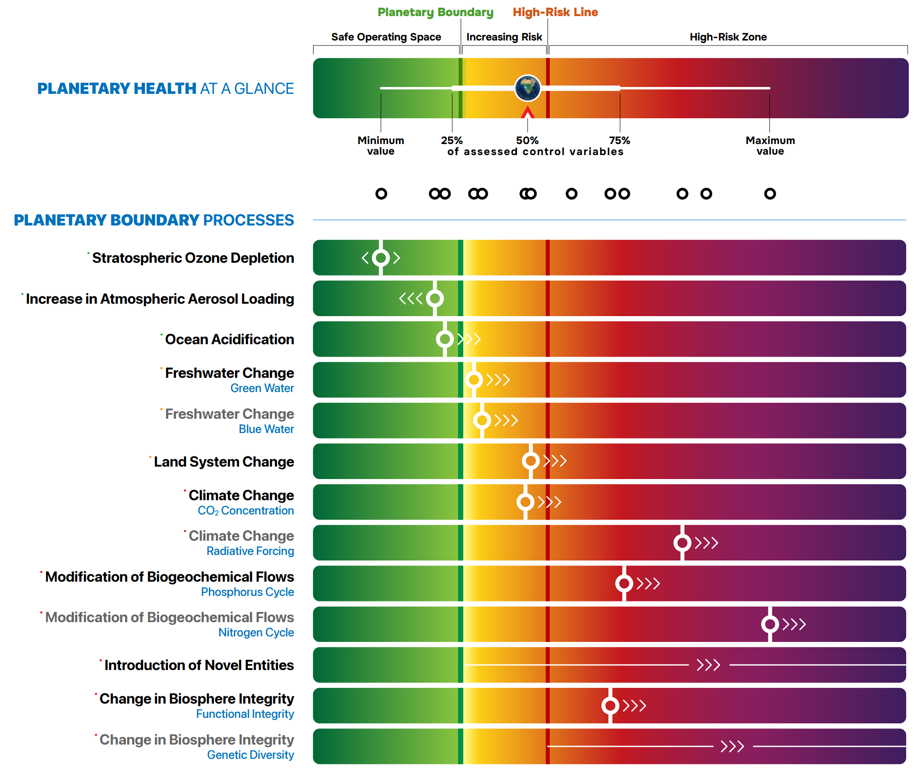
Planetary Boundaries
2024
L. Caesar*, B. Sakschewski*, L. S. Andersen, T. Beringer, J. Braun, D.
Dennis, D. Gerten, A. Heilemann, J. Kaiser, N.H. Kitzmann, S. Loriani, W. Lucht, J. Ludescher, M. Martin, S. Mathesius, A. Paolucci, S. te Wierik, J. Rockström, 2024, Planetary Health Check Report 2024. Potsdam Institute for Climate Impact Research, Potsdam, Germany – CC BY 4.0.

Slide 33
World3 Model

Slide 34
World3
History – System Dynamics
Developed in the 1960s at MIT by Jay Forrester
Methodology and mathematical modeling technique
Used to understand the nonlinear behaviour of complex systems over time
→ e.g., Forrester created a model called World2

Slide 35
World3
History – System Dynamics
System Dynamics modeling starts with defining levels (stocks) and their rates (flows)
“Laundry lists” specify the set of influencing factors for each of the rate variables
Levels:
Population (Inflows: Birth rate | Outflows: Death rate)
Money (Inflows: Income | Outflows: Expenses)
Laundry list for “Birth rate”:
Population
Standard of living
Food Quality
Food Quantity
Education
Contraceptives
F. E. Cellier (2008) – World3 in Modelica: Creating System Dynamics Models in the Modelica Framework – Link

Slide 36
World3
History – System Dynamics
System Dynamics modeling starts with defining levels (stocks) and their rates (flows)
“Laundry lists” specify the set of influencing factors for each of the rate variables
Levels:
Population (Inflows: Birth rate | Outflows: Death rate)
Money (Inflows: Income | Outflows: Expenses)
Laundry list for “Birth rate”:
Population
Standard of living
Food Quality
Food Quantity
Education
Contraceptives
F. E. Cellier (2008) – World3 in Modelica: Creating System Dynamics Models in the Modelica Framework – Link

Slide 37
World3
History – System Dynamics
System Dynamics modeling starts with defining levels (stocks) and their rates (flows)
“Laundry lists” specify the set of influencing factors for each of the rate variables
Levels:
Population (Inflows: Birth rate | Outflows: Death rate)
Money (Inflows: Income | Outflows: Expenses)
Laundry list for “Birth rate”:
Population
Standard of living
Food Quality
Food Quantity
Education
Contraceptives
F. E. Cellier (2008) – World3 in Modelica: Creating System Dynamics Models in the Modelica Framework – Link

Slide 38
World3
History – World2 to World3
The Club of Rome (non-governmental organization – NGO) invites Forrester to apply his ideas to the global economy and ecosystem → declines and proceeds with the project without the Club of Rome.
Dennis Meadows (colleague and former student of Forrester) organizes the project for The Club of Rome.
17 researchers spend a year refining and enlarging the Forrester World2 model → World3.
World3 is considerably more complex and more powerful
Brian Hayes (2012) – Computation and the Human Condition (Harvard SEAS) – Link

Slide 39
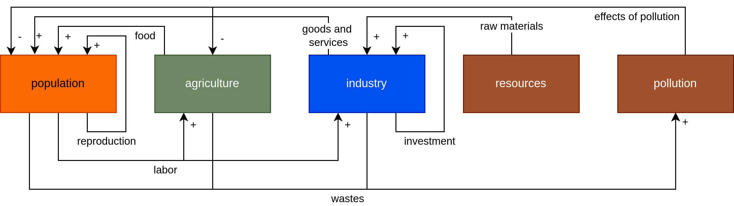
World3
Model Components
Image recreated from: Brian Hayes (2012) – Computation and the Human Predicament – Link

Slide 40
World3
Overview
ca. 150 equations that govern the model
5 main sectors
Population
Agriculture
Industry
Resources
Pollution
Covers the period from 1900 to 2100
Written in a language called DYNAMO

Slide 41
World3
Population
People
Control mechanisms:
Birth rates
Death rates
Maturation → carrying people from one age category to the next

Slide 42
World3
Agriculture
Arable land
Control mechanisms:
Cultivation of new land
Farmland lost due to, e.g., erosion and urban development

Slide 43
World3
Industry
Capital (in USD) representing factories or other productive facilities
Control mechanisms:
Investment input / inflow
Investment outflow / deprecation

Slide 44
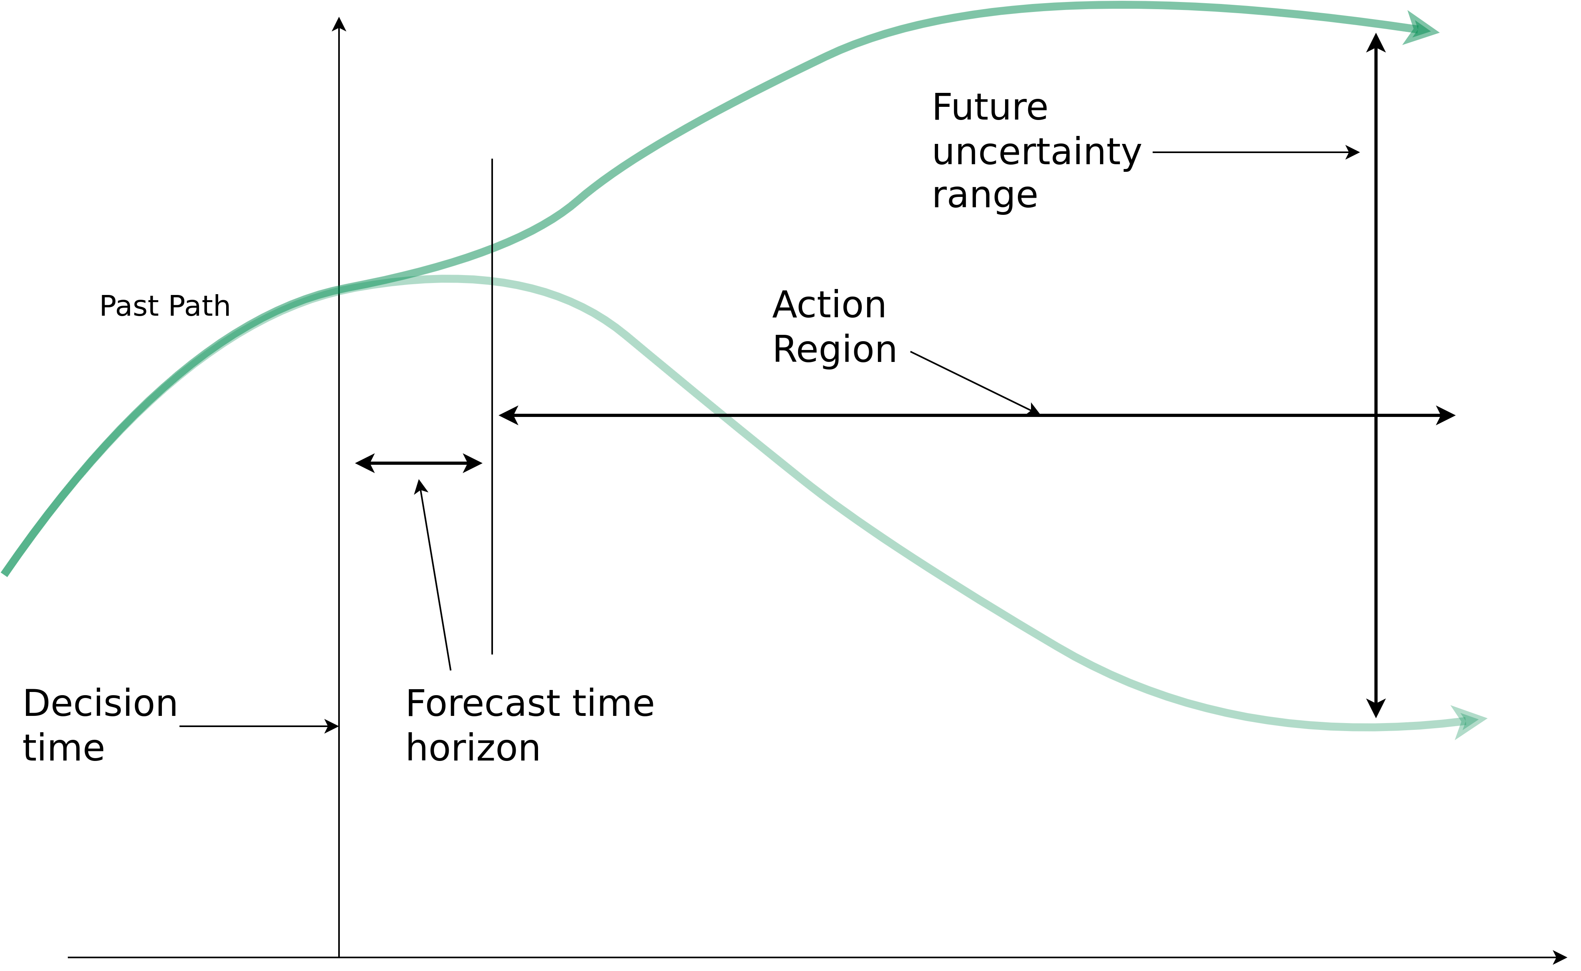
World3
Forrester’s Dilemma
“One can forecast future conditions in the region where action is not effective, and one can have influence in the region where forecasting is not reliable.” – Forrester, 2007
Image recreated from: Brian Hayes (2012) – Computation and the Human Condition (Harvard SEAS) – Link

Slide 45
World3
Simulation Results
Various scenarios based on different assumptions
4 popular scenarios:
Business-as-usual (BAU)
Business-as-usual2 (BAU2) → double the natural resources of BAU
Comprehensive Technology (CT) → BAU2 + exceptionally high technological development and adoption rates
Stabilized Wolrd (SW) → CT + changes in societal values and priorities

Slide 46
World3
Simulation Results
Various scenarios based on different assumptions
4 popular scenarios:
Business-as-usual (BAU)
Business-as-usual2 (BAU2) → double the natural resources of BAU
Comprehensive Technology (CT) → BAU2 + exceptionally high technological development and adoption rates
Stabilized Wolrd (SW) → CT + changes in societal values and priorities

Slide 47
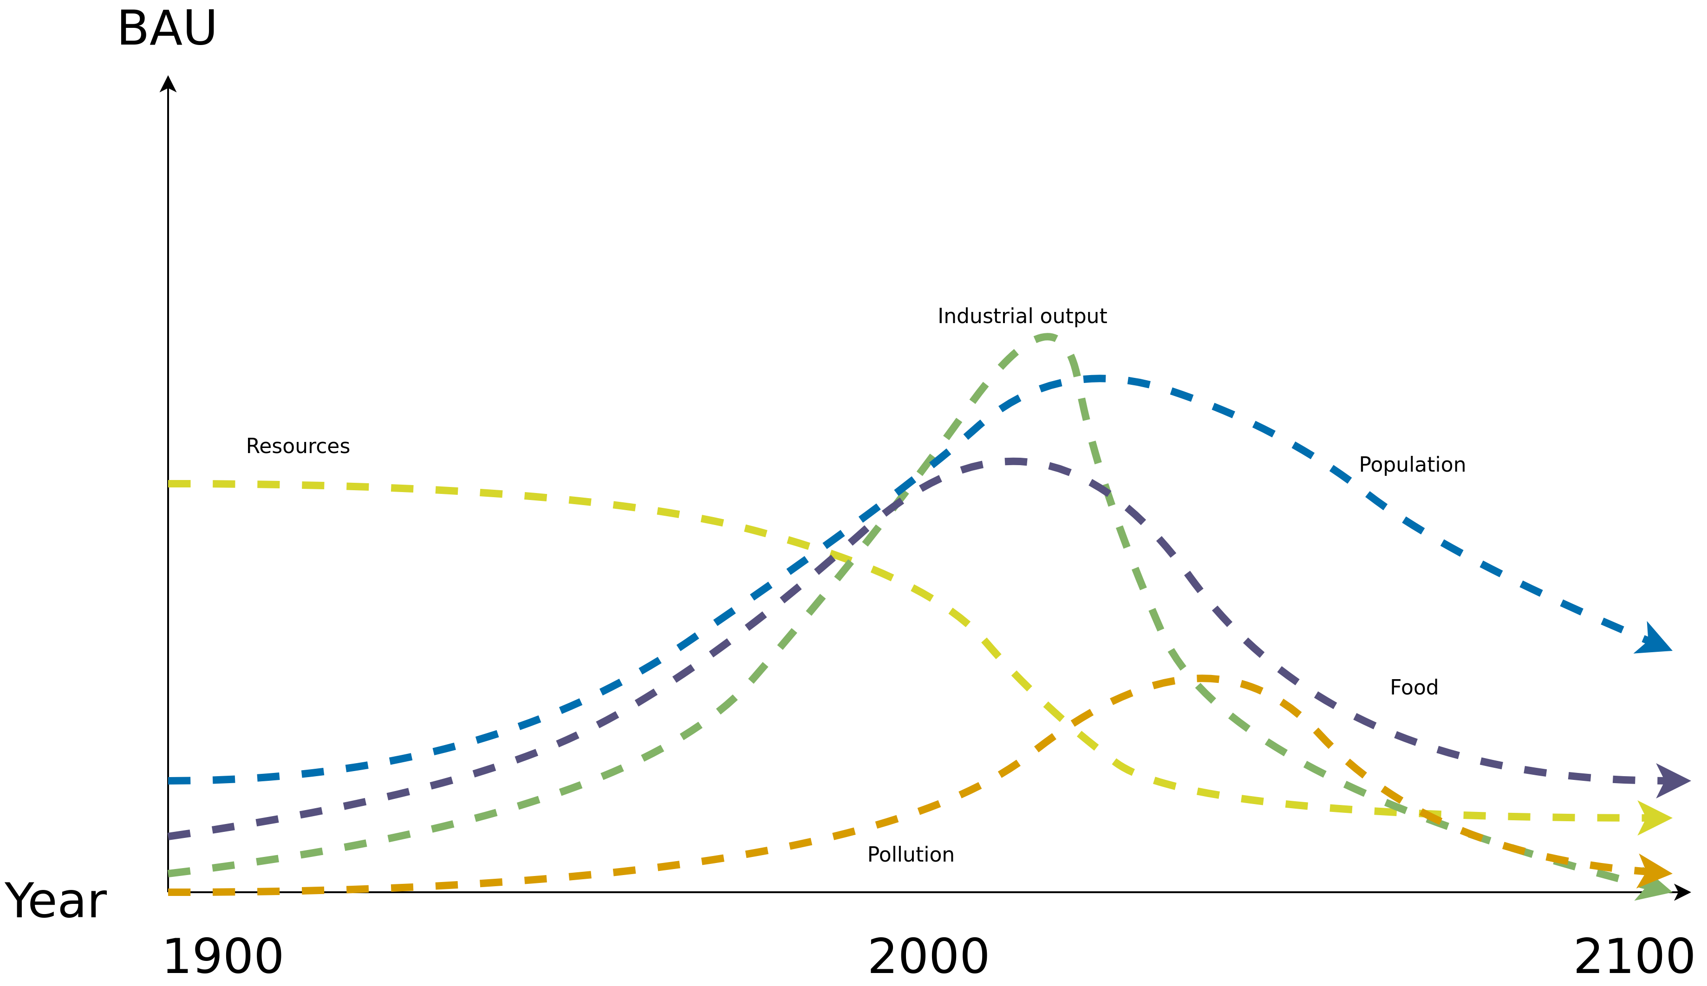
World3
Standard Run – Business-as-Usual (BAU)
Image recreated from: Gaya Herrington (2020) – Update to limits to growth: Comparing the World3 model with empirical data – Link

Slide 48
World3
Standard Run – Business-as-Usual (BAU)
→ Collapse due to natural resource depletion
Image recreated from: Gaya Herrington (2020) – Update to limits to growth: Comparing the World3 model with empirical data – Link

Slide 49
World3
Simulation Results
Various scenarios based on different assumptions
4 popular scenarios:
Business-as-usual (BAU)
Business-as-usual2 (BAU2) → double the natural resources of BAU
Comprehensive Technology (CT) → BAU2 + exceptionally high technological development and adoption rates
Stabilized Wolrd (SW) → CT + changes in societal values and priorities

Slide 50
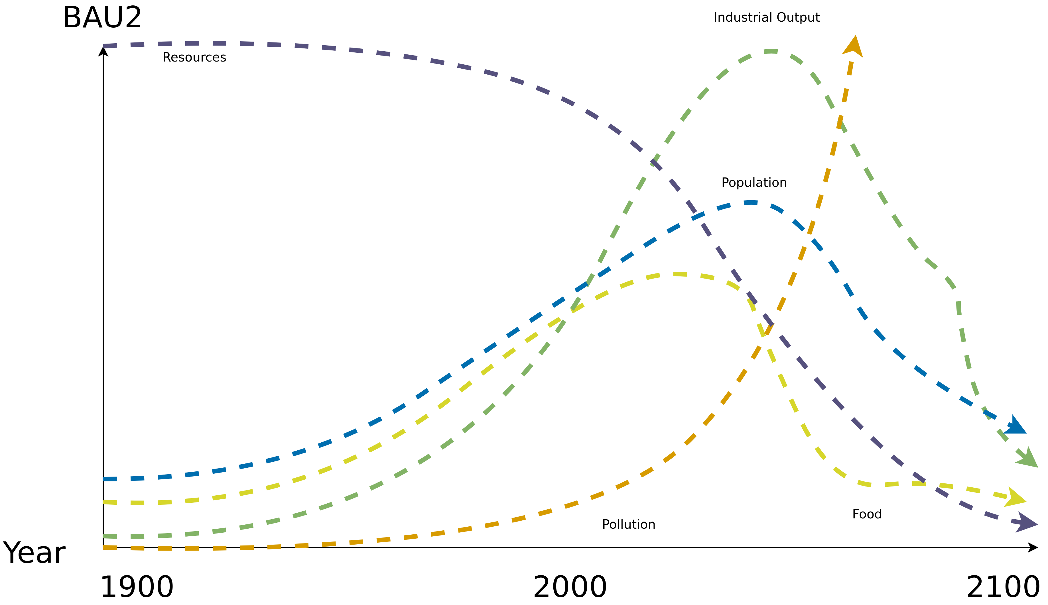
World3
Standard Run – Business-as-Usual2 (BAU2)
Image recreated from: Gaya Herrington (2020) – Update to limits to growth: Comparing the World3 model with empirical data – Link

Slide 51
World3
Standard Run – Business-as-Usual2 (BAU2)
→ Collapse due to pollution (climate change equivalent)
Image recreated from: Gaya Herrington (2020) – Update to limits to growth: Comparing the World3 model with empirical data – Link

Slide 52
World3
Simulation Results
Various scenarios based on different assumptions
4 popular scenarios:
Business-as-usual (BAU)
Business-as-usual2 (BAU2) → double the natural resources of BAU
Comprehensive Technology (CT) → BAU2 + exceptionally high technological development and adoption rates
Stabilized Wolrd (SW) → CT + changes in societal values and priorities

Slide 53
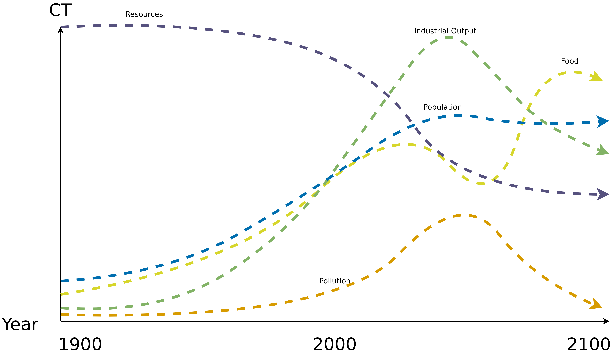
World3
Comprehensive Technology (CT)
Image recreated from: Gaya Herrington (2020) – Update to limits to growth: Comparing the World3 model with empirical data – Link

Slide 54
World3
Comprehensive Technology (CT)
→ Rising costs for technology eventually causes declines, but no collapse
Image recreated from: Gaya Herrington (2020) – Update to limits to growth: Comparing the World3 model with empirical data – Link

Slide 55
World3
Simulation Results
Various scenarios based on different assumptions
4 popular scenarios:
Business-as-usual (BAU)
Business-as-usual2 (BAU2) → double the natural resources of BAU
Comprehensive Technology (CT) → BAU2 + exceptionally high technological development and adoption rates
Stabilized World (SW) → CT + changes in societal values and priorities

Slide 56
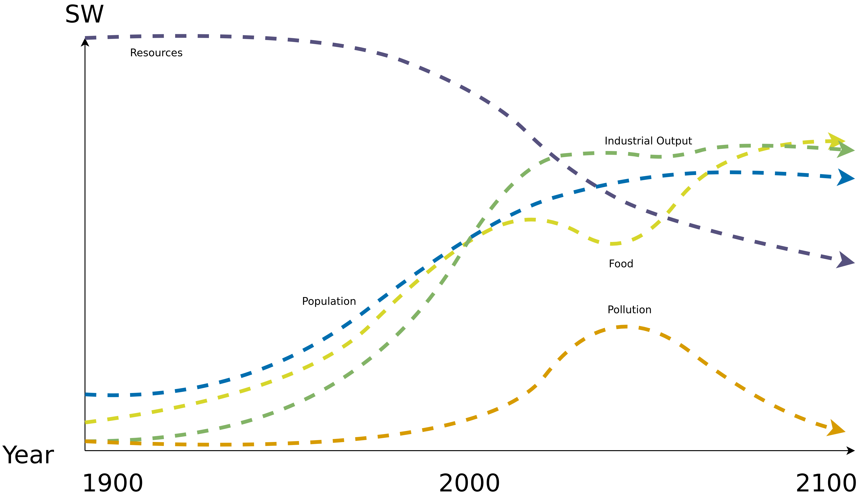
World3
Stabilized World (SW)
Image recreated from: Gaya Herrington (2020) – Update to limits to growth: Comparing the World3 model with empirical data – Link

Slide 57
World3
Stabilized World (SW)
→ Population stabilizes in the twenty-first century, as does human welfare on a high level
Image recreated from: Gaya Herrington (2020) – Update to limits to growth: Comparing the World3 model with empirical data – Link

Slide 58
World3
Simulation Results
Various scenarios based on different assumptions
4 popular scenarios:
Business-as-usual (BAU)
Business-as-usual2 (BAU2) → double the natural resources of BAU
Comprehensive Technology (CT) → BAU2 + exceptionally high technological development and adoption rates
Stabilized Wolrd (SW) → CT + changes in societal values and priorities

Slide 59
World3
Sustainability
World3 indicates that we are already consuming resources at a faster pace than the planet is able to re-grow/generate them
Standard of living is not sustainable
Relieving limiting factors is not a solutions → Instead, it is an accelerator towards disaster
Preventing the worst-case scenario by reducing consumption
F. E. Cellier (2008) – World3 in Modelica: Creating System Dynamics Models in the Modelica Framework – Link

Slide 60
World3
Where are we now?
So which of the 4 scenarios is closest to our current situation?
a) BAU
b) BAU2
c) CT
d) SW

Slide 61
Criticism

Slide 62
Criticism
Model criticized by its creators and others
There is even a complete book dedicated to criticize the model → Models of Doom: A Critique of the Limits to Growth.
Fun fact: Models of Doom is longer than the book it criticizes (Limits to Growth)
1972 book did not contain the equations governing the World3 model
Subsequently released in a further book in 1974 → Dynamics of Growth in a Finite World

Slide 63
Criticism
Heavily criticized by economists → The model questions the fairytale of eternal economic growth
Aggregated variables → one resource, one food, one pollutant, one population
No geographic structure, no social distinctions. "Average food per capita."
Lack of statistical analysis – no error bars
Accused of being too complex and oversimplification
Brian Hayes (2012) – Computation and the Human Condition (Harvard SEAS) – Link

Slide 64
Conclusion

Slide 65
Conclusion
Planetary Boundaries
World3 (1972)→ Modeling the world using System Dynamics
4 commonly used scenarios → BAU, BAU2, CT and SW
SW → Goal
Widespread criticism but the overall message of the World3 model still holds → unsustainable behavior of humans will lead to a collapse of society

Slide 66
Additional Resources
Meadows (1972) – The Limits to Growth.
Meadows, Randers and Meadows (2004) – Limits to Growth – The 30-Year Update.
D. L. Meadows, W. W. Behrens (1974) – Dynamics of Growth in a Finite World.
H. S. D. Cole, Christopher Freeman (1973). Models of Doom: A Critique of the Limits to Growth.
Planetary Boundaries – Stockholm Resilience Center – Link
Planetary Health Check Report 2024. Potsdam Institute for Climate Impact Research – Link
Brian Hayes (2012) – Computation and the Human Condition (Harvard SEAS) – Link

Slide 67
Questions?

